Slide 1
Fake Currency Detection

Slide 2
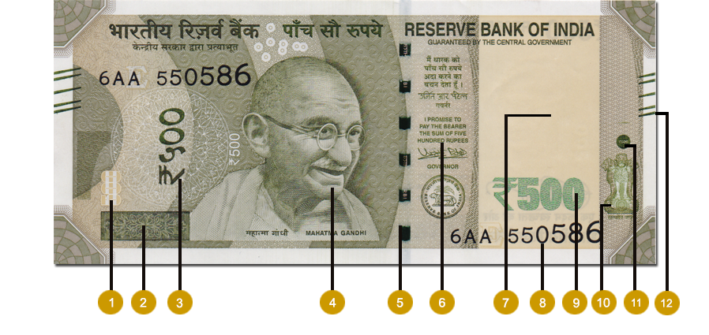
500 Indian Rupee
Limitations:
The Image should be captured in a good light
The Image should be captured straight and not tilted.
The Image should be in good resolution.

Slide 3
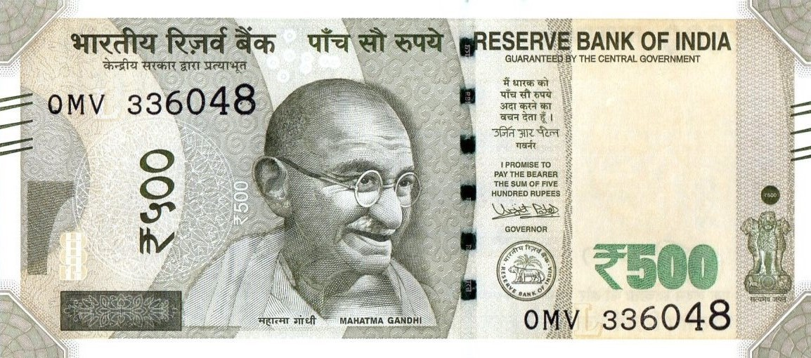
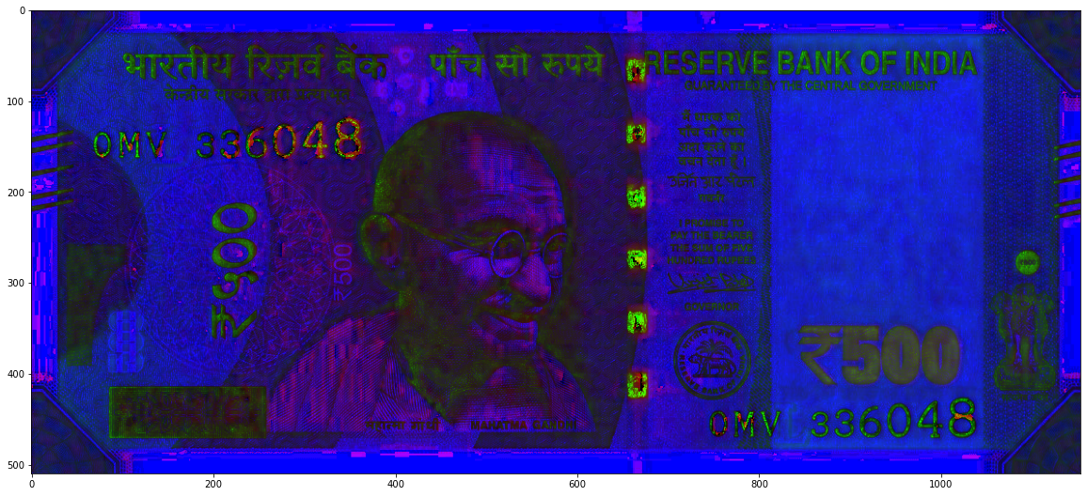
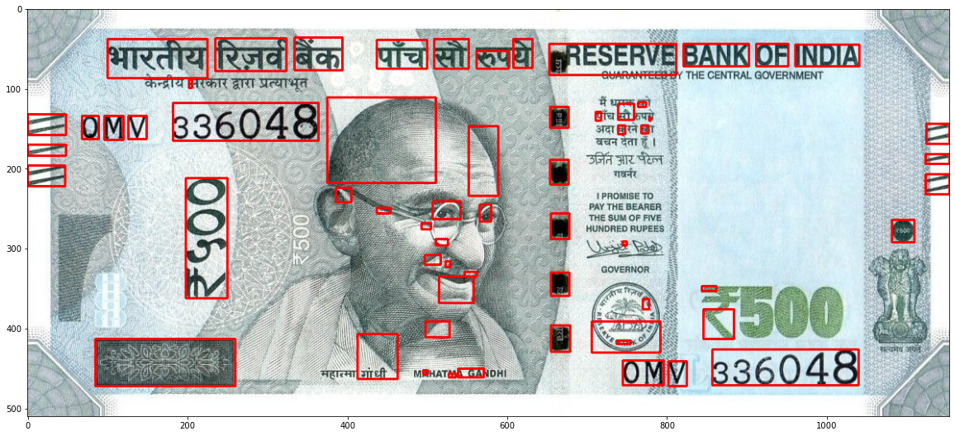
Methadology
Method 1
Method 2

Slide 4
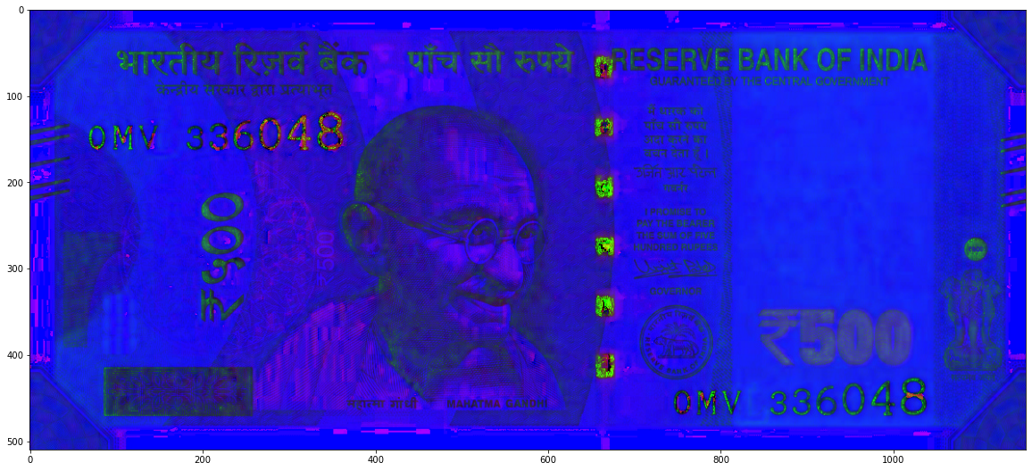
Method 1: Ultra violet
25
1
Histogram equalization
3
Convert_To_HSV
2
Compare
mean saturation

Slide 5
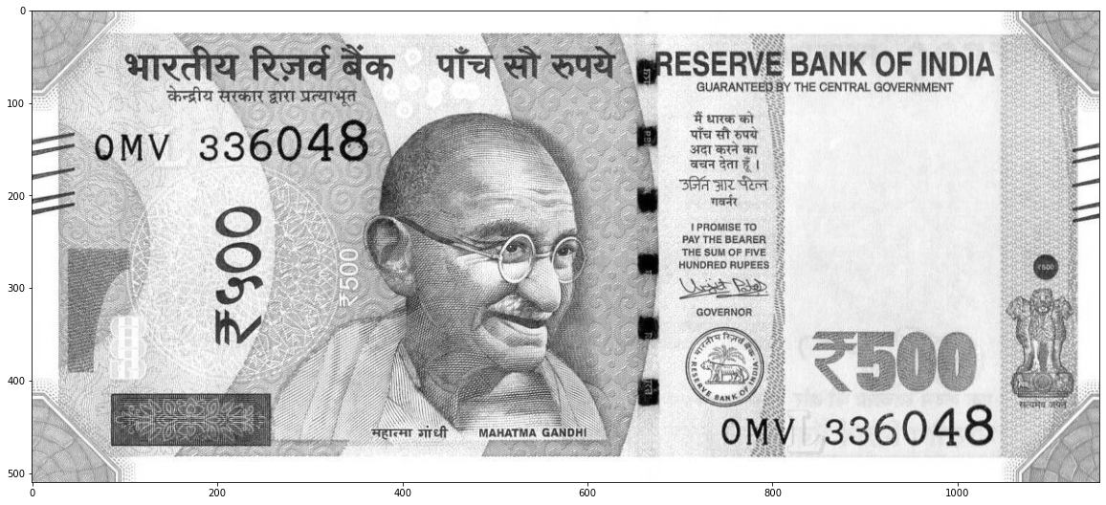
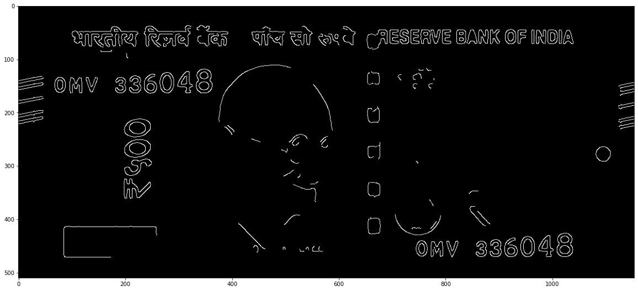
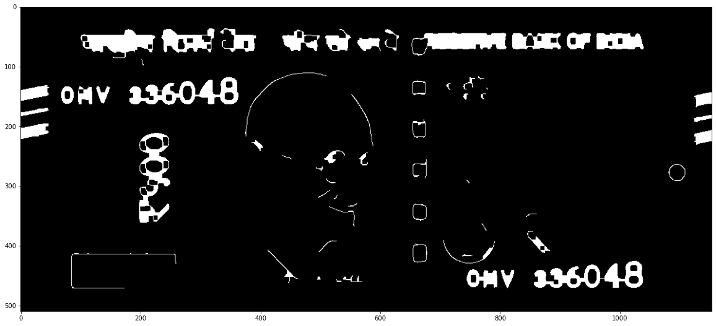
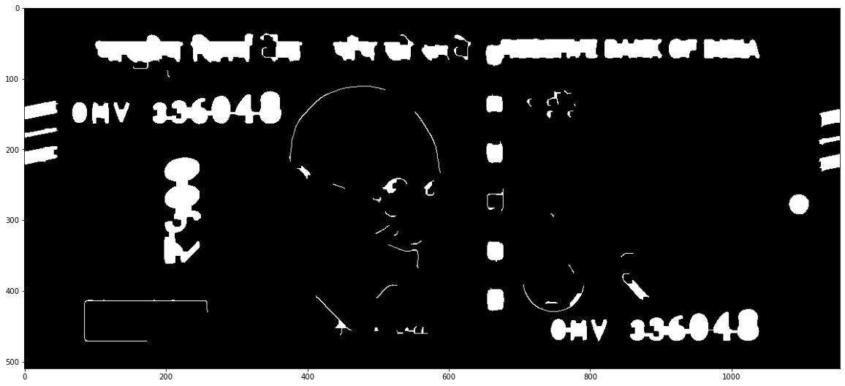
Method 2: Extract Features
Canny-Detector
Closing
1
Convert_To_Gray
2
3
Edge-based Segmentation
Region filling
5
4

Slide 6
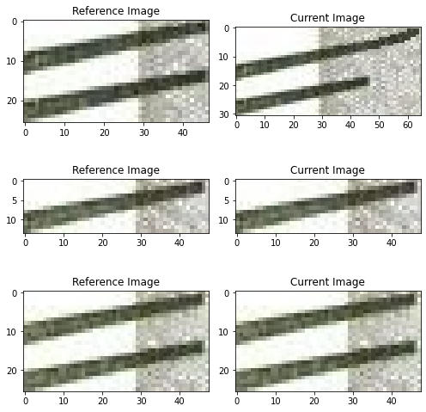
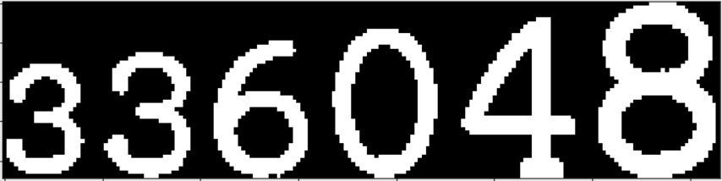
Method 2: Features

Slide 7


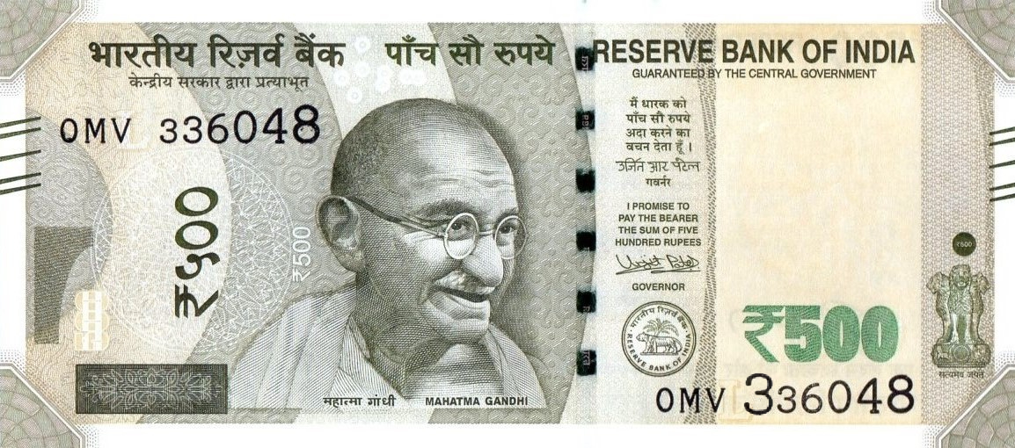
Data
Real
Bleed line
Serial No.
Font size

Slide 8
Blendlines.
Real blend line 1: 47
Current blend line 1: 65
Real blend line 2: 48
Current blend line 2: 48
Real blend line 3: 48
Current blend line 3: 48

Slide 9
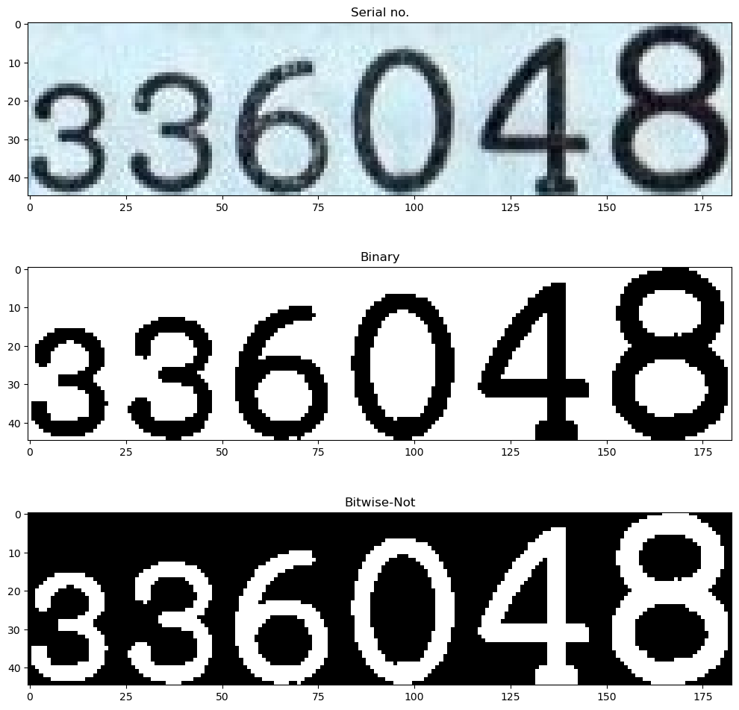
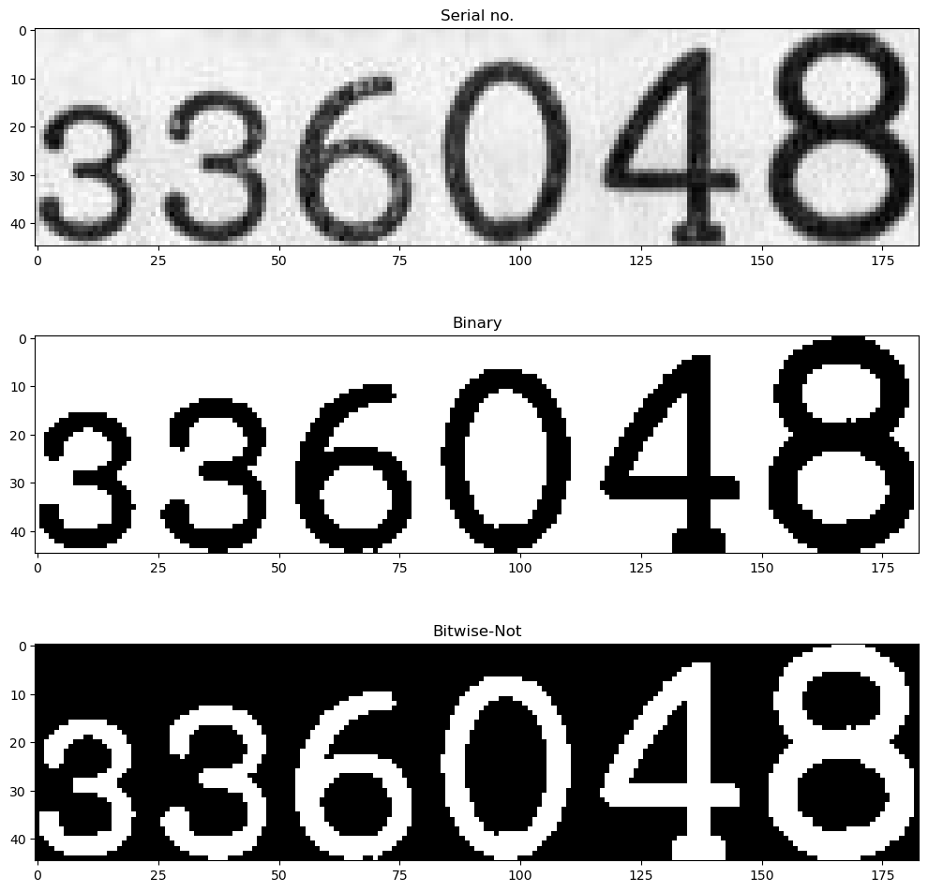
Serial No.
Gray-Scaled
1
2
Serial NO.
Bitwise-Not
Binary
4
3

Slide 10
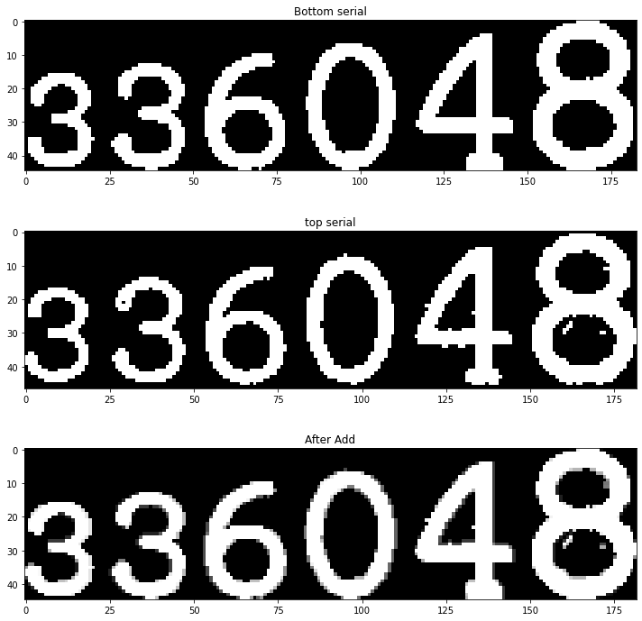
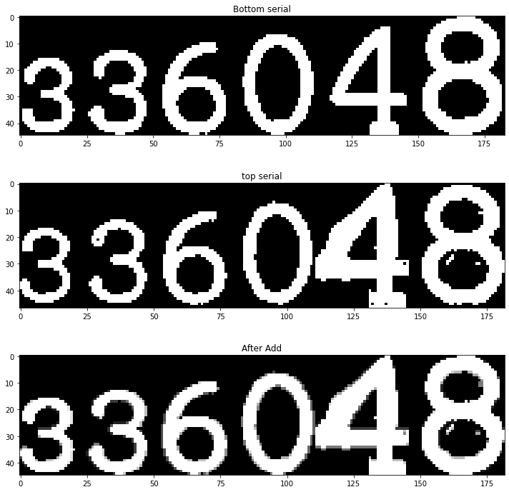
Serial No.
Real
Fake
Serial Intensity: 81.65454977429319
Serial Intensity: 93.51611721611722

Slide 11
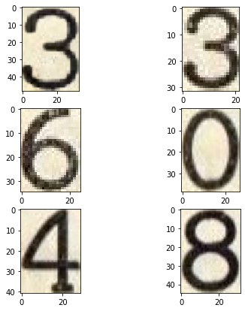
Font Size.
Current---> 33, real---> 21
Current---> 22, real---> 22
Current---> 25, real---> 24
Current---> 27, real---> 27
Current---> 29, real---> 29
Current---> 32, real---> 32

Slide 12
References
https://www.researchgate.net/publication/365977982_COUNTERFEIT_CURRENCY_DETECTION_USING_IMAGE_PROCESSING
https://iopscience.iop.org/article/10.1088/1757-899X/263/5/052047
https://ijcsmc.com/docs/papers/April2019/V8I4201914.pdf
https://www.mintageworld.com/knowledge-base/security-features-on-current-banknotes/

